Slide 1
Damien Suggs
Starting (or Enhancing) an AppSec Program with OpenSAMM: Metro-Atlanta ISSA Chapter
www.saltworkssecurity.com

Slide 2
Objectives
Application Security Architecture: Begin with the end in mind.
OWASP Background
Capability Maturity Model Background
OpenSAMM Components
  OpenSAMM Business Function 1: Governance
  OpenSAMM Business Function 2: Construction
  OpenSAMM Business Function 3: Verification
  OpenSAMM Business Function 4: Operations
Utilizing OpenSAMM to Fit the Organization.

Slide 3
SAMM Adopters
Dell, Inc.
KBC
Gotham Digital Science
Fortify Software
ING Insurance International
ISG
SITA
HP
RES Software
Toreon
TwelveSec
UniSystems S.A.
Transys Greece

Slide 4
SAMM Conferences and Workshops
OpenSAMM Summit Dublin
SAMM Workshop Next Week in Hamburg
SAMM workshops at AppSec EU and AppSec USA

Slide 5
Application Security Architecture

Slide 6
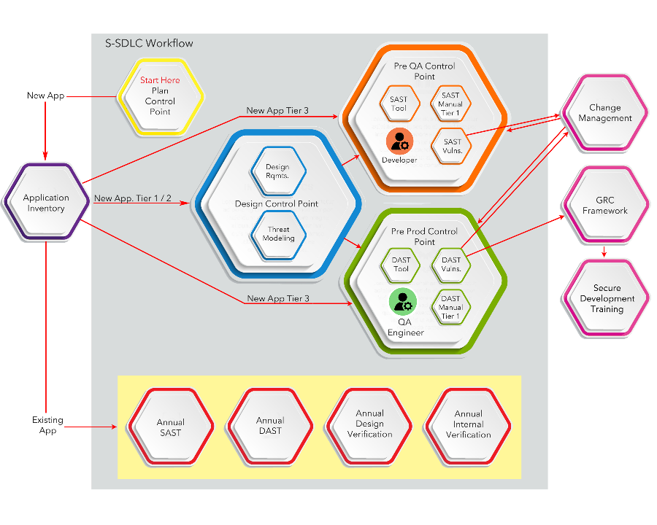

Slide 7
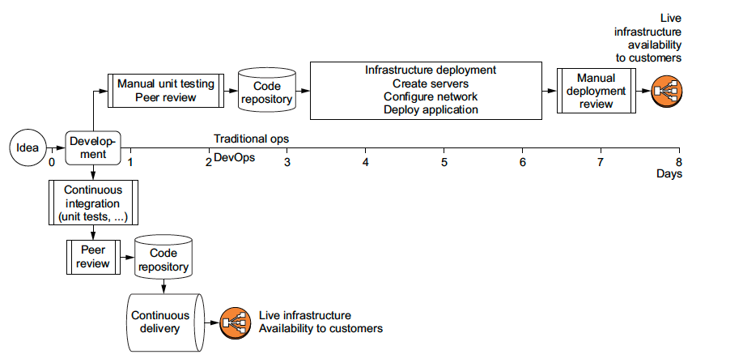
Current/Future State of Development

Slide 8
Build Cycle Cadence

Slide 9
OWASP Background

Slide 10
What is OWASP?
OWASP (Open Web Application Security Program): An open community dedicated to enabling organizations to conceive, develop, acquire, operate, and maintain applications that can be trusted.
Mission Statement: make software security visible, so that individuals and organizations are able to make informed decisions. OWASP is in a unique position to provide impartial, practical information about AppSec to individuals, corporations, universities, government agencies, and other organizations worldwide. Operating as a community of like-minded professionals, OWASP issues software tools and knowledge-based documentation on application security.

Slide 11
OWASP Flagship Projects – Tool Projects
OWASP Zed Attack Proxy (ZAP): Automatically finds security vulnerabilities in your web applications while you are developing and testing your applications
OWASP Web Testing Environment (WTE): A collection of easy-to-use application security tools and documentation available in multiple formats
OWASP OWTF: Pen testing tool to more efficiently find, verify and combine vulnerabilities in short timeframes
OWASP Dependency Check: A utility that identifies project dependencies and checks if there are any known, publicly disclosed, vulnerabilities
OWASP Juice Shop: An intentionally insecure webapp for security trainings written entirely in JavaScript which encompasses the entire OWASP Top Ten and other severe security flaws

Slide 12
OWASP Flagship Projects – Tool Projects (2)
OWASP Security Knowledge Framework: A tool that is used as a guide for building and verifying secure software that can also be used to train developers about application security
OWASP Dependency Track: A Software Composition Analysis (SCA) platform that keeps track of all third-party components used in all the applications an organization creates or consumes. It monitors all applications in its portfolio in order to proactively identify vulnerabilities in components that are placing your applications at risk

Slide 13
OWASP Flagship Projects – Code Projects
OWASP ModSecurity Core Rule Set (CRS):
A set of generic attack detection rules for use with ModSecurity or compatible web application firewalls which aims to protect web applications from a wide range of attacks
OWASP CSRFGuard: A library that implements a variant of the synchronizer token pattern to mitigate the risk of Cross-Site Request Forgery (CSRF) attacks

Slide 14
OWASP Flagship Projects – Documentation Projects
OWASP Application Security Verification Standard: Provides a basis for testing web application technical security controls and also provides developers with a list of requirements for secure development
OWASP AppSensor: A conceptual framework and methodology that offers prescriptive guidance to implement intrusion detection and automated response into applications
OWASP Software Assurance Maturity Model (SAMM): An open framework to help organizations formulate and implement a strategy for software security that is tailored to the specific risks facing the organization
OWASP Top Ten: A powerful awareness document for web application security that represents a broad consensus about the most critical security risks to web applications

Slide 15
OWASP Flagship Projects – Documentation Projects (2)
OWASP Testing Guide: Includes a "best practice" penetration testing framework which users can implement in their own organizations and a "low level" penetration testing guide that describes techniques for testing most common web application and web service security issues
OWASP Cheat Sheet Series: The OWASP Cheat Sheet Series was created to provide a concise collection of high value information on specific application security topics. These cheat sheets were created by various application security professionals who have expertise in specific topics.
OWASP Mobile Security Testing Guide: A security standard for mobile apps and a comprehensive testing guide that covers the processes, techniques, and tools used during a mobile app security test, as well as an exhaustive set of test cases that enables testers to deliver consistent and complete results.

Slide 16
Capability Maturity Model Background

Slide 17
Capability Maturity Model (CMM)
Maturity Level
New opportunities for improving software securities with adoption of new tools/process identified during design, development and tests
Inefficient security activities are identified and replaced
CMM 5: Optimizing
Continuous process improvement. Focus on investment in process automation
Security is able to measure progress in detecting and fixing vulnerabilities earlier in the SDLC
Software risks are managed during the SDLC
Engineering is able to manage cost for vulnerabilities
CMM 4: Managed
Quantitative process control. Focus on product an process quality
Vulnerability Assessment process defined for all applications
Source code analysis process for critical applications
Vulnerability metrics used for risk assessment
CMM 3: Defined
Qualitative process control. Focus on process and organization, proactive process management
Vulnerability scans for High risk applications
Security Coding Standards
Source Code Analysis tools tested
CMM 2: Repeatable
Intuitive process control. Focus on project administration, mostly reactive process management
Security issues addressed by patching existing applications
Hire security consulting company to perform ethical hacking/pen testing
CMM 1: Initial
Ad hoc process. Focus on individual competence, unpredictable cost, schedule and quality
Notes:
In the 1980s, several US military projects involving software subcontractors ran over-budget and were completed far later than planned, if at all. In an effort to determine why this was occurring, the United States Air Force funded a study at the Software Engineering Institute (SEI).
Active development of the model by the US Department of Defense Software Engineering Institute (SEI) began in 1986 when Watts Humphrey joined the Software Engineering Institute located at Carnegie Mellon University in Pittsburgh, Pennsylvania after retiring from 27 years at IBM. At the request of the U.S. Air Force he began formalizing his Process Maturity Framework to aid the U.S. Department of Defense in evaluating the capability of software contractors as part of awarding contracts.
The full representation of the Capability Maturity Model as a set of defined process areas and practices at each of the five maturity levels was initiated in 1991, with Version 1.1 being completed in January 1993.

Slide 18
OpenSAMM Components

Slide 19
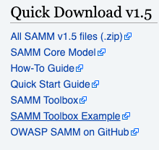
OWASP OpenSAMM from Source
SAMM Core Model
How-To Guide
Quick Start Guide
SAMM Toolbox
SAMM Toolbox Example
OWASP SAMM on GitHub
https://www.owasp.org/index.php/OWASP_SAMM_Project

Slide 20
OWASP OpenSAMM
OpenSAMM V.1.5 (Open Software Assurance Maturity Model)
  An open framework to help organizations formulate and implement a strategy for software security that is tailored to the specific risks facing the organization. The resources provided by SAMM will aid in:
    Evaluating an organization’s existing software security practices.
    Building a balanced software security assurance program in well-defined iterations.
    Demonstrating concrete improvements to a security assurance program.
    Defining and measuring security-related activities throughout an organization.
OpenSAMM is built upon a collection of security practices that are tied back into the core business functions involved in software development.

Slide 21
OWASP OpenSAMM Toolbox
The toolbox consists of 77 questions that assist in helping to understand and articulate the current position of the application assurance program for the organization.
Future targets can be charted and achieved with actionable objectives to better enhance the security posture of the application assurance program.

Slide 22
OWASP OpenSAMM Toolbox Components
Business Function: Each business function is a category of activities related to the nuts-and-bolts of software development, or stated another way, any organization involved with software development must fulfill each of these business functions to some degree.
Security Practice: Each security practice is an area of security-related activities that build assurance for the related business function. There are twelve security practices that are the independent silos for improvement that map to the four business functions of software development.
Maturity Rating: Each level within a security practice is characterized by a successively more sophisticated objective defined by specific activities, and more stringent success metrics than the previous level. Additionally, each security practice can be improved independently, though related activities can lead to optimizations.

Slide 23
OWASP OpenSAMM Toolbox Components (2)
There are four critical Business Functions of software development that are captured using the OpenSAMM questionnaire.
  Governance: centered on the processes and activities related to how an organization manages overall software development activities
  Construction: concerns the processes and activities related to how an organization defines goals and creates software within development projects.
  Verification: focused on the processes and activities related to how an organization checks, and tests artifacts produced throughout software development.
  Operations: entails the processes and activities related to how an organization manages software releases that has been created
Three Security Practices defined within each Business Function.
Each Security Practice measured by a maturity rating
  0 = Implicit starting point representing the activities in the practice being unfulfilled
  1 = Initial understanding and ad hoc provision of security practice.
  2 = Increase efficiency and/or effectiveness of the security practice.
  3 = Comprehensive mastery of the security practice at scale.

Slide 24
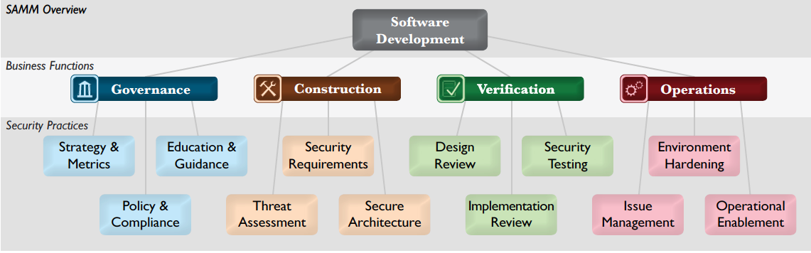
OWASP OpenSAMM Toolbox Components (3)

Slide 25
OWASP OpenSAMM Toolbox Audience
Developers: Individuals performing detailed design and implementation of the software.
Architects: Individuals performing high-level design work and large-scale system engineering.
Managers: Individuals performing day-to-day management of development staff.
QA Testers: Individuals performing quality assurance testing and pre-release verification of software.
Security: Individuals with technical security knowledge related to software being produced.
Business Owners: Individuals performing key decision making on software and its business requirements.
Support Operations: Individuals performing customer support or direct technical operations support.

Slide 26
OpenSAMM Business Function 1: Governance

Slide 27
First Business Function – Governance
Strategy & Metrics: involves the overall strategic direction of the software assurance program and instrumentation of processes and activities to collect metrics about an organization’s security posture.
Policy & Compliance: involves setting up a security, compliance, and audit control framework throughout an organization to achieve increased assurance in software under construction and in operation.
Education & Guidance: involves increasing security knowledge amongst personnel in software development through training and guidance on security topics relevant to individual job functions.

Slide 28
Strategy & Metrics: SM1 - Establish a unified strategic roadmap for software security within the organization.
Activities
Estimate overall business risk profile
Build and maintain assurance program roadmap
Desired Results
Concrete list of the most critical business-level risks caused by software
Tailored roadmap that addresses the security needs for your organization with minimal overhead.
Organization-wide understanding of how the assurance program will grow over time

Slide 29
SM1-A: Strategy & Metrics
Question 1: Is there a software security assurance program in place?
Guidance:
Assurance program is documented and accessible to staff.
Assurance program has been used in recent development efforts.
Staff receives training against assurance program and responsibilities.
Possible Answers:
No
Yes, It's less than a year old.
Yes, It’s a number of years old.
Yes, It’s a pretty mature program.

Slide 30
SM1-B: Strategy & Metrics
Question 2: Are development staff aware of future plans for the assurance program?
Guidance:
Assurance program goals are documented and accessible to staff.
Assurance program goals have been presented to staff.
A plan has been put in place to reach those goals in a specific period of time.
Possible Answers:
No
Yes, a small percentage are.
Yes, at least half of them are.
Yes, the majority of them are.

Slide 31
SM1-C: Strategy & Metrics
Question 3: Do the business stakeholders understand your organization’s risk profile?
Guidance:
Organization has documented motivation behind creating a software security assurance program.
Assurance program has been customized to align with the organization's motivation and goals.
Worst-case scenarios for organization's application and data assets have been collected and documented.
Scenarios, contributing factors, and mitigating factors have been reviewed with business owners and other stakeholders.
Possible Answers:
No
Yes, a small percentage do.
Yes, at least half of them do.
Yes, the majority of them do.

Slide 32
Strategy & Metrics: SM2 - Measure relative value of data and software assets and choose risk tolerance.
Activities:
Classify data and applications based on business risk
Establish and measure per classification security goals
Desired Results:
Customized assurance plans per project based on core value to the business
Organization-wide understanding of security-relevance of data and application assets
Better informed stakeholders with respect to understanding and accepting risks

Slide 33
Application Tiering
  Is the application facing the internet?
  What is the user population of the app?
  Is the application dealing with sensitive (‘Restricted’ or ‘Confidential’) data?
  Does the application contain any patented or intellectual property?
  Does the application have any regulatory requirements?
  Does the application affect business decision processes?
  Does this application have input/output interfaces to other applications? If so, what is the Tier for those apps?
  Does the application support an authentication mechanism?
  Does the application support an authorization mechanism?

Slide 34
Application Tiering (Cont.)
Data Level | Definition
Restricted or Confidential | Any Information that has legal consequences whether disclosed internally or externally or any information that, if improperly disclosed, will cause damage to company’s brand, business revenues, business partners, and/or the privacy of its customers or associates.
Private | Any Information that involves company, its business partners and/or its customers and associates; but is not overly sensitive in nature.
Public | Any Information that is intended and made available for public consumption.

Slide 35
Application Tiering (Cont.)
Attack Surface | Definition
Internet | These applications are available to a large user group over the Internet. There may be strict authentication methods in place; but the application is still accessible to the public.
Intranet | These applications are only available to users who have access to a network that is not publicly available over the Internet; but is not necessarily confined to employees of one company. It is most likely a network that is shared between business entities.
Internal | These applications are only accessible from other locations within the private network and cannot be reached over the Internet.

Slide 36
Application Tiering (Cont.)
Criticality Level | Definition
Critical | These applications, if compromised can have immediate impact on client/patient health information or the organization’s finances
Important | These applications, if compromised can have an impact on client/patient health information or organization’s finance in a few days but not immediately.
Strategic | These applications do not have direct correlation with client/patient health information or organization’s finance, however, if compromised, these applications can indirectly hit the organization’s bottom line.
Internal Support | This category covers Intranet facing applications used for smooth functioning of the organization.

Slide 37
Application Tiering (Cont.)
Risk Rating | Definition
Tier 1 | An example of this type of app would be an Internet-facing application processing ‘Restricted’ or ‘Confidential’ data such as credit card data or PHI.
Tier 2 | An example of this type of app would be an Intranet facing website that allows for quote requests with no other ecommerce capabilities
Tier 3 | An example of this type of application would be a static website available on the internal network with no sensitive or confidential data

Slide 38
Application Tiering (Cont.)
Application Tiering |  | Data Sensitivity
 |  | Restricted or Confidential | Private | Public
Business Criticality | Critical | Tier 1 | Tier 1 | Tier 2
 | Important | Tier 1 | Tier 2 | Tier 3
 | Strategic | Tier 1 | Tier 2 | Tier 3
 | Internal Support | Tier 2 | Tier 2 | Tier 3

Slide 39
SM2-A: Strategy & Metrics
Question 4: Are many of your applications and resources categorized by risk?
Guidance:
A data and application risk classification system has been documented.
An evaluation criteria has been created to apply the classification system to data and applications.
Staff receives training in how to apply evaluation criteria to application and data assets.
Most applications and data have been categorized using this evaluation criteria.
Possible Answers:
No
Yes, a small percentage are.
Yes, at least half of them are.
Yes, the majority of them are.

Slide 40
SM2-B: Strategy & Metrics
Question 5: Are risk ratings used to tailor the required assurance activities?
Guidance:
The assurance program is customized based on data and application risk classification.
Possible Answers:
No
Yes, a small percentage are.
Yes, at least half of them are.
Yes, the majority of them are.

Slide 41
SM2-C: Strategy & Metrics
Question 6: Does the organization know about what’s required based on risk ratings?
Guidance:
Staff receives training according to documented assurance program and risk classifications.
Possible Answers:
No
Yes, a small percentage do.
Yes, at least half of them do.
Yes, the majority of them do.

Slide 42
Strategy & Metrics: SM3 - Align security expenditure with relevant business indicators and asset values.
Activities:
Conduct periodic industry wide cost comparisons
Collect metrics for historic security spend
Desired Results:
Information to make informed case-by-case decisions on security expenditures
Estimates of past loss due to security issues
Per-project consideration of security expense versus loss potential
Industry-wide due diligence with regard to security

Slide 43
SM3-A: Strategy & Metrics
Question 7: Is per-project data for the cost of assurance activities collected?
Guidance:
Statistics are collected for spending related to security incidents or breaches.
Baseline security costs are estimated based on each project based on it's assigned security assurance road map and risk category.
Actual security spending is tracked for each project.
Actual spending vs. estimated spending is evaluated on a quarterly basis.
Spending statistics and historical data are used to make case-by-case decisions on security expenditures.
Security spending decisions are made on a per project basis with consideration for expense versus loss potential.
Possible Answers:
No
Yes, a small percentage do.
Yes, at least half of them do.
Yes, the majority of them do.

Slide 44
SM3-B: Strategy & Metrics
Question 8: Does your organization regularly compare your security spend with that of other organizations?
Guidance:
Statistics regarding similar organization's security spending is collected regularly.
Compare potential cost savings by purchasing products or switching vendors for security tools.
Security cost-comparison exercises are conducted at least annually.
Possible Answers:
No
Yes, we did it once.
Yes, we do it every few years.
Yes, we do it at least annually.

Slide 45
Policy & Compliance: PC1 - Understand relevant governance and compliance drivers to the organization.
Activities:
Identify and monitor external compliance drivers
Build and maintain compliance guidelines
Desired Results:
Increased assurance for handling third party audit with positive outcome
Alignment of internal resources based on priority of compliance requirements
Timely discovery of evolving regulatory requirements that affect your organization

Slide 46
PC1-A: Policy & Compliance
Question 9: Do project stakeholders know their project’s compliance status?
Guidance:
Project stakeholders review project's compliance status biannually.
Possible Answers:
No
Yes, a small percentage do.
Yes, at least half of them do.
Yes, the majority of them do.

Slide 47
PC1-B: Policy & Compliance
Question 10: Are compliance requirements specifically considered by project teams?
Guidance:
External, third-party regulatory or compliance requirements have been identified.
A consolidated list of regulatory and compliance requirements has been mapped to security requirements.
Control statements or responses have been created for each security requirement indicating how the organization will meet the requirement.
Security requirements are added to each project based on applicable regulatory and compliance standards.
The organization researches and updates regulatory or compliance requirements biannually.
Possible Answers:
No
No, it is not applicable.
Yes, but on an ad-hoc basis.
Yes

Slide 48
Policy & Compliance: PC2 - Establish security and compliance baseline and understand per-project risks
Activities:
Build policies and standards for security and compliance
Establish project audit practice
Desired Results:
Awareness for project teams regarding expectations for both security and compliance
Business owners that better understand specific compliance risks in their product lines
Optimized approach for efficiently meeting compliance with opportunistic security improvement

Slide 49
PC2-A: Policy & Compliance
Question 11: Does the organization utilize a set of policies and standards to control software development?
Guidance:
A set of security policies has been created based on compliance drivers.
Optional or recommended compliance items have been added to security policies.
Requirements based on known business drivers for security have been added to security policies.
Common or similar policies have been grouped, generalized, and rewritten to satisfy compliance and security requirements.
Security policies do not include requirements that are too costly or difficult for project teams to comply.
Awareness programs have been created to advertise and spread awareness of security policies.
Possible Answers:
No
Yes, teams write/run their own
Yes, there is a standard set.
Yes, the standard set and it is integrated.

Slide 50
PC2-B: Policy & Compliance
Question 12: Are project teams able to request an audit for compliance with policies and standards?
Guidance:
A process has been created for project teams to request an audit against security policies and compliance requirements.
Internal audits are prioritized based on business risk indicators.
Each project undergoes an audit at least biannually.
Awareness programs have been created to advertise and spread awareness of the organization's audit process.
Audit results are reviewed by project stakeholders including per requirement pass/fail status, impact, and remediation.
Possible Answers:
No
Yes, a small percentage are/do.
Yes, at least half of them are/do.
Yes, the majority of them are/do.

Slide 51
Policy & Compliance: PC3 - Require compliance and measure projects against organization-wide policies and standards
Activities:
Create compliance gates for projects
Adopt solution for audit data collection
Desired Results:
Organization-level visibility of accepted risks due to non-compliance
Concrete assurance for compliance at the project level
Accurate tracking of past project compliance history
Efficient audit process leveraging tools to cut manual effort

Slide 52
PC3-A: Policy & Compliance
Question 13: Are projects periodically audited to ensure a baseline of compliance with policies and standards?
Guidance:
Compliance and security gates are established throughout the development process.
An exception approval process has been created for legacy or other specialized projects.
Automated tools (code review, penetration testing, etc) are used to assist in identifying non-compliance prior to the audit process.
Possible Answers:
No
Yes, a small percentage are.
Yes, at least half of them are.
Yes, the majority of them are.

Slide 53
PC3-B: Policy & Compliance
Question 14: Does the organization systematically use audits to collect and control compliance evidence?
Guidance:
An automated system is used to capture, organize, and display audit data and documentation.
Access to audit data is controlled based on a need to know
Instructions and procedures for accessing audit data are published and advertised to project groups.
Possible Answers:
No
Yes, localized to business areas.
Yes, across the organization.
Yes, across the organization and required.

Slide 54
Education & Guidance: EG1 - Offer development staff access to resources around the topics of secure programming and deployment.
Activities:
Conduct technical security awareness training
Build and maintain technical guidelines
Desired Results:
Increased developer awareness on the most common problems at the code level
Maintain software with rudimentary security best practices in place
Set baseline for security know how among technical staff
Enable qualitative security checks for baseline security knowledge

Slide 55
EG1-A: Education & Guidance
Question 15: Have developers been given high-level security awareness training?
Guidance:
Application security awareness training is provided to all developers.
Training covers topics such as common vulnerabilities and best practice recommendations for eliminating vulnerabilities.
Training is conducted at least annually as well as on demand based on need.
Possible Answers:
No
Yes, we did it once.
Yes, we do it every few years.
Yes, we do it annually.

Slide 56
EG1-B: Education & Guidance
Question 16: Does each project team understand where to find secure development best-practices and guidance?
Guidance:
Resources regarding secure development practices have been assembled and made available to developers.
Management informs development groups that they are expected to utilize secure development resources.
A checklist based on the secure development resources has been created to ensure guidelines are met during development.
Possible Answers:
No
Yes, a small percentage do.
Yes, at least half of them do.
Yes, the majority of them do.

Slide 57
Education & Guidance: EG2 - Educate all personnel in the software life-cycle with role-specific guidance on secure development.
Activities:
Conduct role-specific application security training
Utilize security coaches to enhance project teams
Desired Results:
End-to-end awareness of the issues that leads to security vulnerabilities at the product, design, and code levels
Build plans to remediate vulnerabilities and design flaws in on-going projects
Enable qualitative security checkpoints at requirements, design, and development stages
Deeper understanding of security issues encourages more proactive security planning

Slide 58
EG2-A: Education & Guidance
Question 17: Are those involved in the development process given role-specific security training and guidance?
Guidance:
Role specific application security training is given to developers, architects, QA, etc.
Managers and requirements specifiers receive training in security requirements planning, vulnerability and incident management, threat modeling, and misuse/abuse case design.
Testers and auditors receive training in code review, architecture and design analysis, runtime analysis, and effective security test planning.
Developer training includes security design patterns, tool-specific training, threat modeling and software assessment techniques.
Role specific training is provided at least annually as well as on demand based on need.
Possible Answers:
No
Yes, a small percentage are.
Yes, at least half of them are.
Yes, the majority of them are.

Slide 59
EG2-B: Education & Guidance
Question 18: Are stakeholders able to pull in security coaches for use on projects?
Guidance:
Internal or external security experts are available to project teams for consultation.
The process for requesting these experts is advertised to project teams.
A set security analysts or security-savvy developers have been selected as security coaches.
Possible Answers:
No
Yes, a small percentage are/do.
Yes, at least half of them are/do.
Yes, the majority of them are/do.

Slide 60
Education & Guidance: EG3 - Mandate comprehensive security training and certify personnel for baseline knowledge.
Activities:
Create formal application security support portal
Establish role-based examination/certification
Desired Results:
Efficient remediation of vulnerabilities in both ongoing and legacy code bases
Quickly understand and mitigate against new attacks and threats
Measure the amount of security knowledge of the staff and measure against a common standard
Establish fair incentives toward security awareness

Slide 61
EG3-A: Education & Guidance
Question 19: Is security-related guidance centrally controlled and consistently distributed throughout the organization?
Guidance:
A centralized repository has been created to organize secure development information, resources, and processes.
An approval board and change control management process is in place to control modification of information in this repository.
A method for collaboration and communication of secure development topics has been provided.
Content is searchable based on common factors like platform, language, library, life-cycle stage, etc.
Possible Answers:
No
Yes, teams write/run their own
Yes, there is a standard set.
Yes, the standard set and it is integrated.

Slide 62
EG3-B: Education & Guidance
Question 20: Are developers tested to ensure a baseline skill-set for secure development practices?
Guidance:
Exams are used to verify retention of security knowledge in a per training module or per role context.
Exams are given to staff at least biannually.
Staff are organized or ranked based on exam scores.
Some security activities or gates require staff of a certain rank to sign off before the item is marked as complete.
Possible Answers:
No
Yes, a small percentage are.
Yes, at least half of them are.
Yes, the majority of them are.

Slide 63
OpenSAMM Business Function 2: Construction

Slide 64
Second Business Function – Construction
Threat Assessment: involves accurately identifying and characterizing potential attacks upon an organization’s software in order to better understand the risks and facilitate risk management.
Security Requirements: involves promoting the inclusion of security-related requirements during the software development process in order to specify correct functionality from inception.
Secure Architecture: involves bolstering the design process with activities to promote secure-by-default designs and control over technologies and frameworks upon which software is built.

Slide 65
Threat Assessment: TA1 - Identify and understand high-level threats to the organization and individual projects.
Activities:
Build and maintain application specific threat models
Develop attacker profile from software architecture
Desired Results:
High-level understanding of factors that may lead to negative outcomes
Increased awareness of threats amongst project teams
Inventory of threats for your organization

Slide 66
TA1-A: Threat Assessment
Question 21: Do projects in your organization consider and document likely threats?
Guidance:
Likely worst-case scenarios are documented for each project based on its business risk profile.
Attack trees or a threat model is created for each project tracing the preconditions necessary for a worst-case scenario to be realized.
Attack trees or threat models are expanded to include potential security failures in current and historical functional requirements.
When new features are added to a project, attack trees or threat models are updated.
Possible Answers:
No
Yes, a small percentage do.
Yes, at least half of them do.
Yes, the majority of them do.

Slide 67
TA1-B: Threat Assessment
Question 22: Does your organization understand and document the types of attackers it faces?
Guidance:
Potential external threat agents and their motivations are documented for each project.
Potential internal threat agents, their associated roles, and damage potential are documented for each project or architecture type.
A common set of threat agents, motivations, and other information is collected at the organization level and re-used within projects.
Possible Answers:
No
Yes, a small percentage do.
Yes, at least half of them do.
Yes, the majority of them do.

Slide 68
Threat Assessment: TA2 - Increase accuracy of threat assessment and improve granularity of per-project understanding.
Activities:
Build and maintain abuse case models per project
Adopt a weighting system for measurement of threats
Desired Results:
Granular understanding of likely threats to individual projects
Framework for better trade off decisions within project teams
Ability to prioritize development efforts within a project team based on risk weighting

Slide 69
TA2-A: Threat Assessment
Question 23: Do project teams regularly analyze functional requirements for likely abuses?
Guidance:
Each project derives abuse-cases from its use-cases.
As project requirements or features are added, abuse-cases are updated.
Possible Answers:
No
Yes, a small percentage do.
Yes, at least half of them do.
Yes, the majority of them do.

Slide 70
TA2-B: Threat Assessment
Question 24: Do project teams use a method of rating threats for relative comparison?
Guidance:
A documented weighting system based on documented threat agents, exploit value, technical difficulty, and other factors is used to rank threats.
Remediation of vulnerabilities is prioritized based on the weighting system.
Possible Answers:
No
Yes, a small percentage do.
Yes, at least half of them do.
Yes, the majority of them do.

Slide 71
TA2-C: Threat Assessment
Question 25: Are stakeholders aware of relevant threats and ratings?
Guidance:
Potential threats and ratings are reviewed with project stakeholders.
Possible Answers:
No
Yes, a small percentage are.
Yes, at least half of them are.
Yes, the majority of them are.

Slide 72
Threat Assessment: TA3 - Concretely align compensating controls to each threat against internal and third-party software.
Activities:
Explicitly evaluate risk from third-party components
Elaborate threat models with compensating controls
Desired Results:
Deeper consideration of full threat profile for each software project
Detailed mapping of assurance features to established threats against each software project
Artifacts to document due diligence based on business function of each software project

Slide 73
TA3-A: Threat Assessment
Question 26: Do project teams specifically consider risk from external software?
Guidance:
Third-party, external libraries and code used in each project are clearly identified and documented for each project.
Project threat models are updated based on identified threat agents and motivations for third party libraries and code.
Possible Answers:
No
Yes, a small percentage are.
Yes, at least half of them are.
Yes, the majority of them are.

Slide 74
TA3-B: Threat Assessment
Question 27: Are the majority of the protection mechanisms and controls captured and mapped back to threats?
Guidance:
An assessment for each project has been conducted to identify mitigating controls that prevent preconditions identified in attack trees or threat models.
This assessment is updated each time new features or requirements are introduced or the attack tree is modified.
Mitigating controls have been documented within the attack tree or threat model.
Mitigating controls or security requirements have been added to each project to address any preconditions that still lead to a successful attack within attack trees.
Possible Answers:
No
Yes, a small percentage are.
Yes, at least half of them are.
Yes, the majority of them are.

Slide 75
Security Requirements: SR1 - Consider security explicitly during the software requirements process.
Activities:
Derive security requirements from business functionality
Evaluate security and compliance guidance for requirements
Desired Results:
High-level alignment of development effort with business risks
Ad hoc capturing of industry best-practices for security as explicit requirements
Awareness amongst stakeholders of measures being taken to mitigate risk from software

Slide 76
SR1-A: Security Requirements
Question 28: Do project teams specify security requirements during development?
Guidance:
Security requirements are derived from functional requirements and customer/organization concerns.
A security auditor leads specification of security requirements within each project.
Security requirements are specific, measurable, and reasonable.
Security requirements are documented for each project.
Possible Answers:
No
Yes, a small percentage do.
Yes, at least half of them do.
Yes, the majority of them do.

Slide 77
SR1-B: Security Requirements
Question 29: Do project teams pull requirements from best practices and compliance guidance?
Guidance:
Industry best practices are used to derive additional security requirements.
Existing code bases are analyzed by a security auditor for opportunities to add security requirements.
Plans to refactor existing code to implement security requirements are prioritized by project stakeholders including risk management, senior developers, and architects.
Possible Answers:
No
Yes, teams write/run their own
Yes, there is a standard set.
Yes, the standard set and it is integrated.

Slide 78
Security Requirements: SR2 - Increase granularity of security requirements derived from business logic and known risks.
Activities:
Build an access control matrix for resources and capabilities
Specify security requirements based on known risks
Desired Results:
Detailed understanding of attack scenarios against business logic
Prioritized development effort for security features based on likely attacks
More educated decision making for tradeoffs between features and security efforts
Stakeholders that can better avoid functional requirements that inherently have security flaws

Slide 79
SR2-A: Security Requirements
Question 30: Do stakeholders review access control matrices for relevant projects?
Guidance:
Users, roles, and privileges are identified in each project.
Resources and capabilities are identified in each project.
A matrix of roles and capabilities is documented for each project.
As new features are introduced, the matrix documentation is updated.
The matrix is reviewed with project stakeholders prior to release.
Possible Answers:
No
Yes, a small percentage do.
Yes, at least half of them do.
Yes, the majority of them do.

Slide 80
SR2-B: Security Requirements
Question 31: Do project teams specify requirements based on feedback from other security activities?
Guidance:
Additional security requirements are created based on feedback from code reviews, penetration tests, risk assessments, or other security activities.
Possible Answers:
No
Yes, a small percentage do.
Yes, at least half of them do.
Yes, the majority of them do.

Slide 81
Security Requirements: SR3 - Mandate security requirements process for all software projects and third-party dependencies.
Activities:
Build security requirements into supplier agreements
Expand audit program for security requirements
Desired Results:
Formally set baseline for security expectations from external code
Centralized information on security effort undertaken by each project team
Ability to align resources to projects based on application risk and desired security requirements

Slide 82
SR3-A: Security Requirements
Question 32: Do stakeholders review vendor agreements for security requirements?
Guidance:
During the creation of third-party agreements, specific security requirements, activities, and processes are considered for inclusion.
Possible Answers:
No
Yes, a small percentage do.
Yes, at least half of them do.
Yes, the majority of them do.

Slide 83
SR3-B: Security Requirements
Question 33: Are audits performed against the security requirements specified by project teams?
Guidance:
Audits are routinely performed to ensure security requirements have been specified for all functional requirements.
Audits also verify attack trees are constructed and mitigating controls are annotated.
A list of unfulfilled security requirements and their projected implementation date is documented.
Security requirement audits is performed on every development iteration prior to the implementation of code.
Possible Answers:
No
Yes, we did it once.
Yes, we do it every few years.
Yes, we do it at least annually.

Slide 84
Security Architecture: SA1 - Insert consideration of proactive security guidance into the software design process.
Activities:
Maintain list of recommended software frameworks
Explicitly apply security principles to design
Desired Results:
Ad hoc prevention of unexpected dependencies and one-off implementation choices
Stakeholders aware of increased project risk due to libraries and frameworks chosen
Established protocol within development for proactively applying security mechanisms to a design

Slide 85
SA1-A: Security Architecture
Question 34: Are project teams provided with a list of recommended third-party components?
Guidance:
A weighted list of commonly used third-party libraries and code is collected and documented across the organization.
The libraries are informally evaluated for security based on past incidents, responses to identified issues, complexity, and appropriateness to the organization. Risk associated with these components are documented.
A list of approved third-party libraries for use within development projects is published.
Possible Answers:
No
Yes, teams write/run their own
Yes, there is a standard set.
Yes, the standard set and it is integrated.

Slide 86
SA1-B: Security Architecture
Question 35: Are project teams aware of secure design principles and do they apply them consistently?
Guidance:
A list of secure design principles (such as defense in depth) have been collected and documented.
These principles are used as a checklist during the design phase of each project.
Possible Answers:
No
Yes, a small percentage are/do.
Yes, at least half of them are/do.
Yes, the majority of them are/do.

Slide 87
Security Architecture: SA2 - Direct the software design process toward known secure services and secure-by-default designs.
Activities:
Identify and promote security services and infrastructure
Identify security design patterns from architecture
Desired Results:
Detailed mapping of assets to user roles to encourage better compartmentalization in design
Reusable design building blocks for provision of security protections and functionality
Increased confidence for software projects from use of established design techniques for security

Slide 88
SA2-A: Security Architecture
Question 36: Do you advertise shared security services with guidance for project teams?
Guidance:
A list of reusable resources is collected and categorized based on the security mechanisms they fulfill (LDAP server, single sign-on server, etc.).
The organization has selected a set of reusable resources to standardize on.
These resources have been thoroughly audited for security issues.
Design guidance has been created for secure integration of each component within a project.
Project groups receive training regarding the proper use and integration of these components.
Possible Answers:
No
Yes, localized to business areas.
Yes, across the organization.
Yes, across the organization and required.

Slide 89
SA2-B: Security Architecture
Question 37: Are project teams provided with prescriptive design patterns based on their application architecture?
Guidance:
Each project is categorized based on architecture (client-server, web application, thick client, etc.).
A set of design patterns is documented for each architecture (Risk-based authentication system, single sign-on, centralized logging, etc.).
Architects, senior developers, or other project stakeholders identify applicable and appropriate patterns for each project during the design phase.
Possible Answers:
No
Yes, teams write/run their own
Yes, there is a standard set.
Yes, the standard set and it is integrated.

Slide 90
Security Architecture: SA3 - Formally control the software design process and validate utilization of secure components.
Activities:
Establish formal reference architectures and platforms
Validate usage of frameworks, patterns, and platforms
Desired Results:
Customized application development platforms that provide built-in security protections
Organization-wide expectations for proactive security effort in development
Stakeholders better able to make tradeoff decisions based on business need for secure design

Slide 91
SA3-A: Security Architecture
Question 38: Do project teams build software from centrally-controlled platforms and frameworks?
Guidance:
Each project is categorized based on architecture (client-server, web application, Reusable code components based on established design patterns and shared security services have been created for used within projects across the organization.
Reusable code components are regularly maintained, updated, and assessed for risk.
Possible Answers:
No
Yes, a small percentage do.
Yes, at least half of them do.
Yes, the majority of them do.

Slide 92
SA3-B: Security Architecture
Question 39: Are project teams audited for the use of secure architecture components?
Guidance:
Audits include evaluation of usage of recommended frameworks, design patterns, shared security services, and reference platforms.
Results are used to determine if additional frameworks, resources, or guidance need to be specified as well as the quality of guidance provided to project teams.
Possible Answers:
No
Yes, we did it once.
Yes, we do it every few years.
Yes, we do it at least annually.

Slide 93
OpenSAMM Business Function 3: Verification

Slide 94
Third Business Function – Verification
Design Review: involves inspection of the artifacts created from the design process to ensure provision of adequate security mechanisms, and adherence to an organization’s expectations for security.
Implementation Review: involves assessment of an organization’s source code to aid vulnerability discovery and related mitigation activities as well as establish a baseline for secure coding expectations.
Security Testing: involves testing the organization’s software in its runtime environment, in order to both discover vulnerabilities, and establish a minimum standard for software releases.

Slide 95
Design Review: DR1 - Support ad hoc reviews of software design to ensure baseline mitigations for known risks.
Activities:
Identify software attack surface
Analyze design against known security requirements
Desired Results:
High-level understanding of security implications from perimeter architecture
Enable development teams to self-check designs for security best-practices
Lightweight process for conducting project level design reviews

Slide 96
DR1-A: Design Review
Question 40: Do project teams document the attack perimeter of software designs?
Guidance:
Each project group creates a simplified one-page architecture diagram representing high-level modules.
Each component in the diagram is analyzed in terms of accessibility of the interface from authorized users, anonymous users, operators, application-specific roles, etc.
Interfaces and components with similar accessibility profiles are grouped and documented as the software attack surface.
One-page architecture diagram is annotated with security-related functionality.
Grouped interface designs are evaluated to determine whether security-related functionality is applied consistently.
Architecture diagrams and attack surface analysis is updated when an application's design is altered.
Possible Answers:
No
Yes, a small percentage do.
Yes, at least half of them do.
Yes, the majority of them do.

Slide 97
DR1-B: Design Review
Question 41: Do project teams check software designs against known security risks?
Guidance:
Each project group documents a list of assumptions the software relies on for safe execution.
Each project group documents a list of security requirements for the application.
Each project's one-page architecture diagram is evaluated for security requirements and assumptions. Missing items are documented as findings.
Evaluations are repeated when security requirements are added or the high-level system design changes occur within a project.
Possible Answers:
No
Yes, a small percentage do.
Yes, at least half of them do.
Yes, the majority of them do.

Slide 98
Design Review: DR2 - Offer assessment services to review software design against comprehensive best practices for security.
Activities:
Inspect for complete provision of security mechanisms
Deploy design review service for project teams
Desired Results:
Formally offered assessment service to consistently review architecture for security
Pinpoint security flaws in maintenance-mode and legacy systems
Deeper understanding amongst project stakeholders on how the software provides assurance protections

Slide 99
DR2-A: Design Review
Question 42: Do project teams specifically analyze design elements for security mechanisms?
Guidance:
Each interface within the high-level architecture diagram is formally inspected for security mechanisms (includes internal and external application tiers).
Analysis includes the following minimum categories: authentication, authorization, input validation, output encoding, error handling, logging, cryptography, and session management.
Each software release is required to undergo a design review.
Possible Answers:
No
Yes, a small percentage do.
Yes, at least half of them do.
Yes, the majority of them do.

Slide 100
DR2-B: Design Review
Question 43: Are project stakeholders aware of how to obtain a formal secure design review?
Guidance:
A process for requesting a formal design review is created and advertised to project stakeholders.
The design review process is centralized and requests are prioritized based on the organization's business risk profile.
Design reviews include verification of software's attack surface, security requirements, and security mechanisms within module interfaces.
Possible Answers:
No
Yes, some of them are aware.
Yes, approximately half of them are aware.
Yes, most of them are aware.

Slide 101
Design Review: DR3 - Require assessments and validate artifacts to develop detailed understanding of protection mechanisms.
Activities:
Develop data-flow diagrams for sensitive resources
Establish release gates for design review
Desired Results:
Granular view of weak points in a system design to encourage better compartmentalization
Organization-level awareness of project standing against baseline security expectations for architecture
Comparisons between projects for efficiency and progress toward mitigating known flaws

Slide 102
DR3-A: Design Review
Question 44: Does the secure design review process incorporate detailed data-level analysis?
Guidance:
Project teams identify details on system behavior around high-risk functionality (such as CRUD of sensitive data).
Project teams document relevant software modules, data sources, actors, and messages that flow between data sources or business functions.
Utilizing the data flow diagram, project teams identify software modules that handle data or functionality with differing sensitivity levels.
Possible Answers:
No
Yes, a small percentage do.
Yes, at least half of them do.
Yes, the majority of them do.

Slide 103
DR3-B: Design Review
Question 45: Does a minimum-security baseline exist for secure design review results?
Guidance:
A consistent design review program has been established.
A criteria is created to determine whether a project passes the design review process (for example no high-risk findings).
Release gates are used within the development process to ensure projects cannot advance to the next step until the project successfully completes a design review.
A process is established for handling design review results in legacy projects, including a requirement to establish a time frame for successfully completing the design review process.
Possible Answers:
No
Yes, teams write/run their own
Yes, there is a standard set.
Yes, the standard set and it is integrated.

Slide 104
Implementation Review: IR1 - Opportunistically find basic code-level vulnerabilities and other high-risk security issues.
Activities:
Create review checklists from known security requirements
Perform point-review of high-risk code
Desired Results:
Inspection for common configuration or code vulnerabilities that lead to likely discovery or attack
Lightweight review for coding errors that lead to severe security impact
Basic code-level due diligence for security assurance

Slide 105
IR1-A: Implementation Review
Question 46: Do project teams have review checklists based on common security related problems?
Guidance:
The organization has derived a light-weight code review checklist based on previously identified security requirements.
Developers receive training regarding their role and the goals of the checklist.
Possible Answers:
No
Yes, localized to business areas.
Yes, across the organization.
Yes, across the organization and required.

Slide 106
IR1-B: Implementation Review
Question 47: Does a minimum security baseline exist for secure design review results?
Guidance:
High-risk software components are prioritized above other code during the review process.
Security auditors or code review tools are utilized to perform the checklist based code review.
Remediation of findings in high-risk components are prioritized appropriately.
Possible Answers:
No
Yes, teams write/run their own
Yes, there is a standard set.
Yes, the standard set and it is integrated.

Slide 107
Implementation Review: IR2 - Make implementation review during development more accurate and efficient through automation.
Activities:
Utilize automated code analysis tools
Integrate code analysis into development process
Desired Results:
Development enabled to consistently self-check for code level security vulnerabilities
Routine analysis results to compile historic data on per team secure coding habits
Stakeholders aware of unmitigated vulnerabilities to support better tradeoff analysis

Slide 108
IR2-A: Implementation Review
Question 48: Can project teams access automated code analysis tools to find security problems?
Guidance:
The organization has reviewed open source, commercial, and other solution for performing automated code reviews and selected a solution that will best fit the organization.
Automated code analysis has been integrated within the development process (at code check-in for example).
Possible Answers:
No
Yes, teams write/run their own
Yes, there is a standard set.
Yes, the standard set and it is integrated.

Slide 109
IR2-B: Implementation Review
Question 49: Do stakeholders consistently review results from code reviews?
Guidance:
Project stakeholders review and accept any risks that they choose not to address.
Project stakeholders have created a plan for addressing findings in legacy code.
Possible Answers:
No
Yes, a small percentage do.
Yes, at least half of them do.
Yes, the majority of them do.

Slide 110
Implementation Review: IR3 - Mandate comprehensive code review process to discover language-level and application-specific risks.
Activities:
Customize code analysis for application-specific concerns
Establish release gates for implementation review
Desired Results:
Increased confidence in accuracy and applicability of code analysis results
Organization-wide baseline for secure coding expectations
Project teams with an objective goal for judging code-level security

Slide 111
IR3-A: Implementation Review
Question 50: Do project teams utilize automation to check code against application-specific coding standards?
Guidance:
Automated code review tools are customized to perform additional API checks, verify organization coding standards, etc. (including the addition of custom rules).
Possible Answers:
No
Yes, localized to business areas.
Yes, across the organization.
Yes, across the organization and required.

Slide 112
IR3-B: Implementation Review
Question 51: Does a minimum security baseline exist for code review results?
Guidance:
Each project contains a checkpoint in the development process that requires a specific level of code review results to be met before release.
The organization has established an exception process for legacy code, which requires a certain level of assurance to be met within a specific time period
Possible Answers:
No
Yes, teams write/run their own
Yes, there is a standard set.
Yes, the standard set and it is integrated.

Slide 113
Security Testing: ST1 - Establish process to perform basic security tests based on implementation and software requirements.
Activities:
Derive test cases from known security requirements
Conduct penetration testing on software releases
Desired Results:
Independent verification of expected security mechanisms surrounding critical business functions
High-level due diligence toward security testing
Ad hoc growth of a security test suite for each software project

Slide 114
ST1-A: Security Testing
Question 52: Do projects specify security testing based on defined security requirements?
Guidance:
The organization has documented general test cases based on security requirements and common vulnerabilities.
Each project has documented test cases for security requirements specific to that project.
Staff ensures test cases are applicable, feasible, and can be executed by relevant development, security, and quality assurance staff.
Possible Answers:
No
Yes, a small percentage are/do.
Yes, at least half of them are/do.
Yes, the majority of them are/do.

Slide 115
ST1-B: Security Testing
Question 53: Is penetration testing performed on high risk projects prior to release?
Guidance:
Project teams engage security auditors to perform penetration testing.
Penetration testing covers security requirements and test cases at a minimum.
Penetration testing issues are resolved to an acceptable level of risk prior to release.
Possible Answers:
No
Yes, a small percentage are/do.
Yes, at least half of them are/do.
Yes, the majority of them are/do.

Slide 116
ST1-C: Security Testing
Question 54: Are stakeholders aware of the security test status prior to release?
Guidance:
Penetration testing issues are reviewed with project stakeholders.
Project stakeholders select issues to remediate prior to release.
Project stakeholders set a time line for addressing identified issues or accept outstanding risks.
Possible Answers:
No
Yes, some of them are aware.
Yes, approximately half of them are aware.
Yes, most of them are aware.

Slide 117
Security Testing: ST2 - Make security testing during development completer and more efficient through automation.
Activities:
Utilize automated security testing tools
Integrate security testing into development process
Desired Results:
Deeper and more consistent verification of software functionality for security
Development teams enabled to self-check and correct problems before release
Stakeholders better aware of open vulnerabilities when making risk acceptance decisions

Slide 118
ST2-A: Security Testing
Question 55: Do projects use automation to evaluate security test cases?
Guidance:
The organization has reviewed open source, commercial, and other solution for performing automated security testing and selected a solution that will best fit the organization.
Automated security testing has been integrated within the development process.
Possible Answers:
No
Yes, a small percentage do.
Yes, at least half of them do.
Yes, the majority of them do.

Slide 119
ST2-B: Security Testing
Question 56: Do projects follow a consistent process to evaluate and report on security tests to stakeholders?
Guidance:
Automated security testing occurs across projects on a regular, scheduled basis.
A process has been created for reviewing security testing results with project stakeholders and remediating risk.
Possible Answers:
No
Yes, a small percentage do.
Yes, at least half of them do.
Yes, the majority of them do.

Slide 120
Security Testing: ST3 - Require application specific security testing to ensure baseline security before deployment.
Activities:
Employ application-specific security testing automation
Establish release gates for security testing
Desired Results:
Organization-wide baseline for expected application performance against attacks
Customized security test suites to improve accuracy of automated analysis
Project teams aware of objective goals for attack resistance

Slide 121
ST3-A: Security Testing
Question 57: Are security test cases comprehensively generated for application-specific logic?
Guidance:
Using automated tools, unit tests, or other similar methods, a comprehensive set of security test cases is constructed and evaluated for each project.
Possible Answers:
No
Yes, a small percentage do.
Yes, at least half of them do.
Yes, the majority of them do.

Slide 122
ST3-B: Security Testing
Question 58: Does a minimum security baseline exist for security testing?
Guidance:
Each project contains a checkpoint in the development process that requires a specific level of security testing results to be met before release.
The organization has established an exception process for handling security testing results in legacy projects, which requires a certain level of assurance to be met within a specific time period
Possible Answers:
No
Yes, teams write/run their own
Yes, there is a standard set.
Yes, the standard set and it is integrated.

Slide 123
OpenSAMM Business Function 4: Operations

Slide 124
Fourth Business Function – Operations
Issue Management: involves establishing consistent processes for managing internal and external vulnerability reports to limit exposure and gather data to enhance the security assurance program.
Environment Hardening: involves implementing controls for the operating environment surrounding an organization’s software to bolster the security posture of applications that have been deployed.
Operational Enablement: identifying and capturing security-relevant information needed by an operator to properly configure, deploy, and run an organization’s software.

Slide 125
Issue Management: IM1 - Understand high-level plan for responding to issue reports or incidents.
Activities:
Identify point of contact for security issues
Create informal security response team(s)
Desired Results:
Lightweight process in place to handle high-priority issues or incidents
Framework for stakeholder notification and reporting of events with security impact
High-level due diligence for handling security issues.

Slide 126
IM1-A: Issue Management
Question 59: Do projects have a point of contact for security issues or incidents?
Guidance:
Each project or development group has assigned a security-savvy developer to be the point of contact for security issues.
The organization maintains a centralized list of applications, projects, and points of contact regarding security issues.
Possible Answers:
No
Yes, a small percentage do.
Yes, at least half of them do.
Yes, the majority of them do.

Slide 127
IM1-B: Issue Management
Question 60: Does your organization have an assigned security response team?
Guidance:
The organization has defined a centralized security response team responsible for managing incidents, vulnerability reports, remediation, and reporting.
During an incident, the security response team provides briefings and upward communication.
Possible Answers:
No
Yes, It's less than a year old.
Yes, It’s a number of years old.
Yes, It’s a pretty mature program.

Slide 128
IM1-C: Issue Management
Question 61: Are project teams aware of their security point(s) of contact and response team(s)?
Guidance:
The security response team meets with project groups at least annually to brief individuals on the incident response process.
Possible Answers:
No
Yes, a small percentage are.
Yes, at least half of them are.
Yes, the majority of them are.

Slide 129
Issue Management: IM2 - Elaborate expectations for response process to improve consistency and communications.
Activities:
Establish consistent incident response process
Adopt a security issue disclosure process
Desired Results:
Communications plan for dealing with issue reports from third-parties
Clear process for releasing security patches to software operators
Formal process for tracking, handling, and internally communicating about incidents

Slide 130
IM2-A: Issue Management
Question 62: Does the organization utilize a consistent process for incident reporting and handling?
Guidance:
The organization has a documented process for incident handling and reporting, including team members' roles and responsibilities.
The incident response team receives training at least annually.
The incident response process includes items such as triage to prevent additional damage, change management and patch application, managing project personnel and others involved in the incident, forensic evidence collection and preservation, limiting communication about the incident to stakeholders, well-defined reporting to stakeholders and/or communications trees, etc.
The organization has adopted and documented a security issue disclosure process.
The organization has adopted and documented a patch release process.
The organization has adopted and documented a process for collaborating with individuals exercising responsible disclosure.
The organization advertises a process for handling issues disclosed responsibly by third-parties.

Slide 131
IM2-A: Issue Management (Cont.)
Question 62: Does the organization utilize a consistent process for incident reporting and handling?
Guidance:
The organization has adopted and documented a practice for disclosing incidents to the public (if necessary and in compliance of state and federal laws).
Possible Answers:
No
Yes, localized to business areas.
Yes, across the organization.
Yes, across the organization and required.

Slide 132
IM2-B: Issue Management
Question 63: Are project stakeholders aware of relevant security disclosures related to their software projects?
Guidance:
A formal, documented process has been established for tracking, handling, and communicating incidents internally.
Possible Answers:
No
Yes, a small percentage are.
Yes, at least half of them are.
Yes, the majority of them are.

Slide 133
Issue Management: IM3 - Improve analysis and data gathering within response process for feed back into proactive planning.
Activities:
Conduct root cause analysis for incidents
Collect per-incident metrics
Desired Results:
Detailed feedback for organizational improvement after each incident
Rough cost estimation from issue and compromises
Stakeholders better able to make tradeoff decisions based on historic incident trends

Slide 134
IM3-A: Issue Management
Question 64: Are incidents inspected for root causes to generate further recommendations?
Guidance:
Incident response teams investigate root causes of security failures leading to an incident or security issue.
The root cause is used to analyze the project or software for additional potential failures.
The root cause is compared to security requirements and existing processes to determine how to improve security assurance efforts.
The root cause is reviewed with project stakeholders and management to determine a mitigation process and time frame.
Possible Answers:
No
Yes, a small percentage are.
Yes, at least half of them are.
Yes, the majority of them are.

Slide 135
IM3-B: Issue Management
Question 65: Do projects consistently collect and report data and metrics related to incidents?
Guidance:
The organization's centralized incident response process is expanded to collect and record metrics.
Metrics such as frequency of software projects affected by incidents, system downtime and cost from loss of use, human resources taken in handling and cleanup of the incident, estimates of long-term costs such as regulatory fines or brand damage, etc. are collected.
Past security incidents are recorded and reviewed every six months and recommendations to improve the organization or software assurance process are made.
Possible Answers:
No
Yes, a small percentage are.
Yes, at least half of them are.
Yes, the majority of them are.

Slide 136
Environment Hardening: EH1 - Understand baseline operational environment for applications and software components.
Activities:
Maintain operational environment specification
Identify and install critical security upgrades and patches
Desired Results:
Clear understanding of operational expectations within the development team
High-priority risks from underlying infrastructure mitigated on a well understood timeline
Software operators with a high-level plan for security-critical maintenance of infrastructure

Slide 137
EH1-A: Environment Hardening
Question 66: Do projects document operational environment security requirements?
Guidance:
The organization documents and maintains a set of baseline operating platforms.
Project teams expand on existing, approved baseline operating platforms to meet project requirements.
Project teams document assumptions made about operating environments during development.
Organization and project operating platforms are reviewed at least every six months.
Possible Answers:
No
Yes, a small percentage are.
Yes, at least half of them are.
Yes, the majority of them are.

Slide 138
EH1-B: Environment Hardening
Question 67: Do projects check for security updates to third-party software components?
Guidance:
Project teams or the operations team regularly monitors software components for security updates.
Project teams or the operations team apply critical software component updates once identified.
Possible Answers:
No
Yes, a small percentage are.
Yes, at least half of them are.
Yes, the majority of them are.

Slide 139
Environment Hardening: EH2 - Improve confidence in application operations by hardening the operating environment.
Activities:
Establish routine patch management process
Monitor baseline environment configuration status
Desired Results:
Granular verification of security characteristics of systems in operations
Formal expectations on timelines for infrastructure risk mitigation
Stakeholders consistently aware of current operations status of software projects

Slide 140
EH2-A: Environment Hardening
Question 68: Is a consistent process used to apply upgrades and patches to critical dependencies?
Guidance:
A documented ongoing process has been created at the organization level to consistently identify and apply security patches.
The patch management process requires security patches to be applied within a specific time window based on risk.
Project teams share a list of third-party components and a source for updates with the operations team.
Possible Answers:
No
Yes, localized to business areas.
Yes, across the organization.
Yes, across the organization and required.

Slide 141
EH2-B: Environment Hardening
Question 69: Do projects leverage automation to check application and environment health?
Guidance:
The organization has reviewed open source, commercial, and other solution for performing automated monitoring and patch management and has selected a solution that will best fit the organization.
Automated monitoring and patch management tools and processes has been integrated within the organization's operational environments.
Project teams and the operations team document and implement application-level heath checks.
The automated monitoring and patch management tools generate alerts and a documented process for handling and responding to these alerts has been established.
Project teams and the operations team reviews configuration changes and alerts at least quarterly in order to improve current processes.
Possible Answers:
No
Yes, a small percentage do.
Yes, at least half of them do.
Yes, the majority of them do.

Slide 142
Environment Hardening: EH3 - Validate application health and status of operational environment against known best practices.
Activities:
Identify and deploy relevant operations protection tools
Expand audit program for environment configuration
Desired Results:
Reinforced operational environment with layered checks for security
Established and measured goals for operational maintenance and performance
Reduced likelihood of successful attack via flaws in external dependencies

Slide 143
EH3-A: Environment Hardening
Question 70: Are stakeholders aware of options for additional tools to protect software while running in operations?
Guidance:
The security team or operations team reviews optional tools for protecting software with project stakeholders.
Appropriate solutions such as a WAF, IPS, HIDS, etc. are adopted for each project's operational environment.
Possible Answers:
No
Yes, teams write/run their own
Yes, there is a standard set.
Yes, the standard set and it is integrated.

Slide 144
EH3-B: Environment Hardening
Question 71: Does a minimum security baseline exist for environment health (versioning, patching, etc)?
Guidance:
Project-level audits include analysis and testing of the operational environment in which the software resides.
Audits include verification of compliance with the organization's patch management process.
Operational environment audits occur at least every six months.
The organization has established an exception process for legacy operational environments, which requires a certain level of assurance to be met within a specific time period.
Possible Answers:
No
Yes, localized to business areas.
Yes, across the organization.
Yes, across the organization and required.

Slide 145
Operational Enablement: OE1 - Enable communications between development teams and operators for critical security-relevant data.
Activities:
Capture critical security information for deployment
Document procedures for typical application alerts
Desired Results:
Ad hoc improvements to software security posture through better understanding of correct operations
Operators and users aware of their role in ensuring secure deployment
Improved communications between software developers and users for security critical information

Slide 146
OE1-A: Operational Enablement
Question 72: Are security notes delivered with each software release?
Guidance:
Project teams document security-relevant configuration and operations information and provide documentation to users and operators.
Project teams document a list of security features built into the software, options for configuration, security impacts, and include a secure default.
Project stakeholders review security documentation prior to release.
Project teams update security documentation at least every six months.
Possible Answers:
No
Yes, a small percentage are.
Yes, at least half of them are.
Yes, the majority of them are.

Slide 147
OE1-B: Operational Enablement
Question 73: Are security-related alerts and error conditions documented on a per-project basis?
Guidance:
Project teams document important security-related alerts and error conditions and provide the documentation to the operations team.
Project teams update alerts and error conditions documentation at least every six months.
Project teams document an automated or manual process for monitoring and responding to application alerts and errors.
Operations team regularly monitors and responds to application alerts and errors based on provided documentation.
Possible Answers:
No
Yes, a small percentage are.
Yes, at least half of them are.
Yes, the majority of them are.

Slide 148
Operational Enablement: OE2 - Improve expectation for continuous secure operations through provision of detailed procedures.
Activities:
Create per-release change management procedures
Maintain formal operational security guides
Desired Results:
Detailed guidance for security relevant changes delivered with software releases
Updated information repository on secure operating procedures per application
Alignment of operations expectations among developers, operators, and users.

Slide 149
OE2-A: Operational Enablement
Question 74: Do projects utilize a change management process that’s well understood?
Guidance:
The organization has documented and implemented a change management process.
The development process includes steps intended to collect installation or upgrade related information.
Project teams document first-time installation and upgrade instructions.
Project teams review installation and upgrade instructions for completeness and accuracy prior to release.
Project teams communicate Installation and upgrade instructions to the operations team during for release cycle.
Possible Answers:
No
Yes, a small percentage do.
Yes, at least half of them do.
Yes, the majority of them do.

Slide 150
OE2-B: Operational Enablement
Question 75: Do project teams deliver an operational security guide with each product release?
Guidance:
Project teams develop an operational security guide starting with information documented about security-related alerts and errors.
Guides include all security information needed by users and operators.
Guides include items such as: security-related configuration options, event handling procedures, installation and upgrade guides, operational environment specifications, security-related assumptions about the deployment environment, etc.
Project teams work with project stakeholders to determine an appropriate level of detail for the operational security guide.
Project teams update the operational security guide with each release.
Possible Answers:
No
Yes, a small percentage do.
Yes, at least half of them do.
Yes, the majority of them do.

Slide 151
Operational Enablement: OE3 - Mandate communication of security information and validate artifacts for completeness.
Activities:
Expand audit program for operational information
Perform code signing for application components
Desired Results:
Organization-wide understanding of expectations for security relevant documentation
Stakeholders better able to make tradeoff decisions based on feedback from deployment and operations
Operators and/or users able to independently verify integrity of software releases

Slide 152
OE3-A: Operational Enablement
Question 76: Are project releases audited for appropriate operational security information?
Guidance:
The audit process includes verification that projects' operational security guides are complete, contain sufficient details, and are up-to-date.
The organization has established an exception process for legacy projects, which requires a certain level of assurance within the software's operational environment to be met within a specific time period.
Possible Answers:
No
Yes, we did it once.
Yes, we do it every few years.
Yes, we do it at least annually.

Slide 153
OE3-B: Operational Enablement
Question 77: Is code signing routinely performed on software components using a consistent process?
Guidance:
Code signing is used to ensure and verify the authenticity of developed code.
A code signing and key management process has been documented for the organization.
Project teams work with security auditors to determine which components warrant including within the code signing process.
List of included code components is reviewed and updated regularly.
Possible Answers:
No
No, it is not applicable.
Yes, but on an ad-hoc basis.
Yes

Slide 154
OpenSAMM Real Examples

Slide 155
Governance: Strategy & Metrics
Objective 1: Establish a unified strategic roadmap for software security within the organization.
Question 1: Is there a software assurance program in place?
Notes:
Key observation:
Guidance:
Assurance program is documented and accessible to staff.
Assurance program has been used in recent development efforts.
Staff receives training against assurance program and responsibilities.

Slide 156
Governance: Strategy & Metrics
Objective 1: Establish a unified strategic roadmap for software security within the organization.
Question2: Are development staff aware of future plans for the assurance program?
Notes:
Key Observation:
Guidance:
Assurance program goals are documented and accessible to staff.
Assurance program goals have been presented to staff.
A plan has been put in place to reach those goals in a specific period of time.

Slide 157
Construction: Threat Assessment
Objective 1: Identify and understand high-level threats to the organization and individual projects.
Question 2: Does your organization understand and document the types of attackers it faces?
Notes:
Key Observation:
Guidance:
Potential external threat agents and their motivations are documented for each project.
Potential internal threat agents, their associated roles, and damage potential are documented for each project or architecture type.
A common set of threat agents, motivations, and other information is collected at the organization level and re-used within projects.

Slide 158
Construction: Threat Assessment
Objective 2: Increase accuracy of threat assessment and improve granularity of per-project understanding.
Question 2: Do project teams use a method of rating threats for relative comparison?
Notes:
Key Observation:
Guidance:
A documented weighting system based on documented threat agents, exploit value, technical difficulty, and other factors is used to rank threats.
Remediation of vulnerabilities is prioritized based on the weighting system.

Slide 159
Verification: Design Review
Objective 1: Support ad-hoc reviews of software design to ensure baseline mitigations for known risks.
Question 1: Do project teams document the attack perimeter of software designs?
Notes:
Key Observation:
Guidance:
Each project group creates a simplified one-page architecture diagram representing high-level modules.
Each component in the diagram is analyzed in terms of accessibility of the interface from authorized users, anonymous users, operators, application-specific roles, etc..
Interfaces and components with similar accessibility profiles are grouped and documented as the software attack surface.
One-page architecture diagram is annotated with security-related functionality.
Grouped interface designs are evaluated to determine whether security-related functionality is applied consistently.
Architecture diagrams and attack surface analysis is updated when an application's design is altered.

Slide 160
Verification: Design Review
Objective 2: Offer assessment services to review software design against comprehensive best practices for security.
Question 2: Are project stakeholders aware of how to obtain a formal secure design review?
Notes:
Key Observation:
Guidance:
A process for requesting a formal design review is created and advertised to project stakeholders.
The design review process is centralized and requests are prioritized based on the organization's business risk profile.
Design reviews include verification of software's attack surface, security requirements, and security mechanisms within module interfaces.

Slide 161
Operations: Issue Management
Objective 1: Understand high-level plan for responding to issue reports or incidents.
Question 1: Do projects have a point of contact for security issues or incidents?
Notes:
Key Observation:
Guidance:
Each project or development group has assigned a security-savvy developer to be the point of contact for security issues.
The organization maintains a centralized list of applications, projects, and points of contact regarding security issues.

Slide 162
Operations: Environment Hardening
Objective 1: Understand baseline operational environment for applications and software components.
Question 1: Do projects document operational environment security requirements?
Notes:
Key Observation:
Guidance:
The organization documents and maintains a set of baseline operating platforms.
Project teams expand on existing, approved baseline operating platforms to meet project requirements.
Project teams document assumptions made about operating environments during development.
Organization and project operating platforms are reviewed at least every six months.

Slide 163
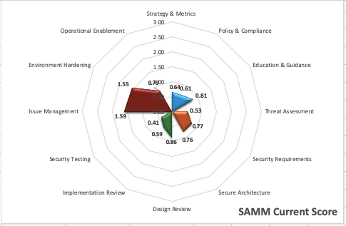
Current State
Operations
Governance
Verification
Construction

Slide 164
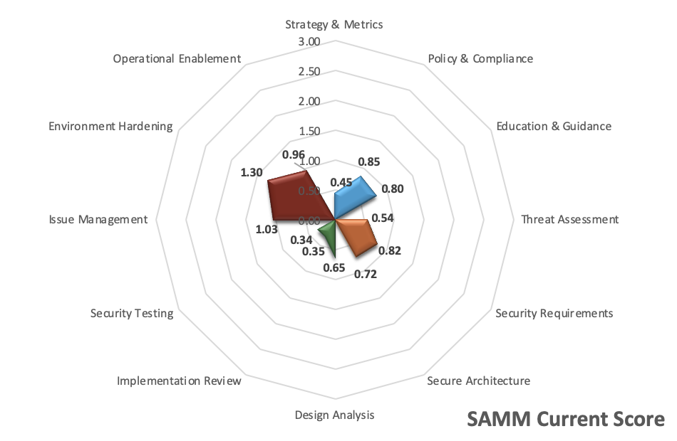
Current State
Operations
Governance
Verification
Construction

Slide 165
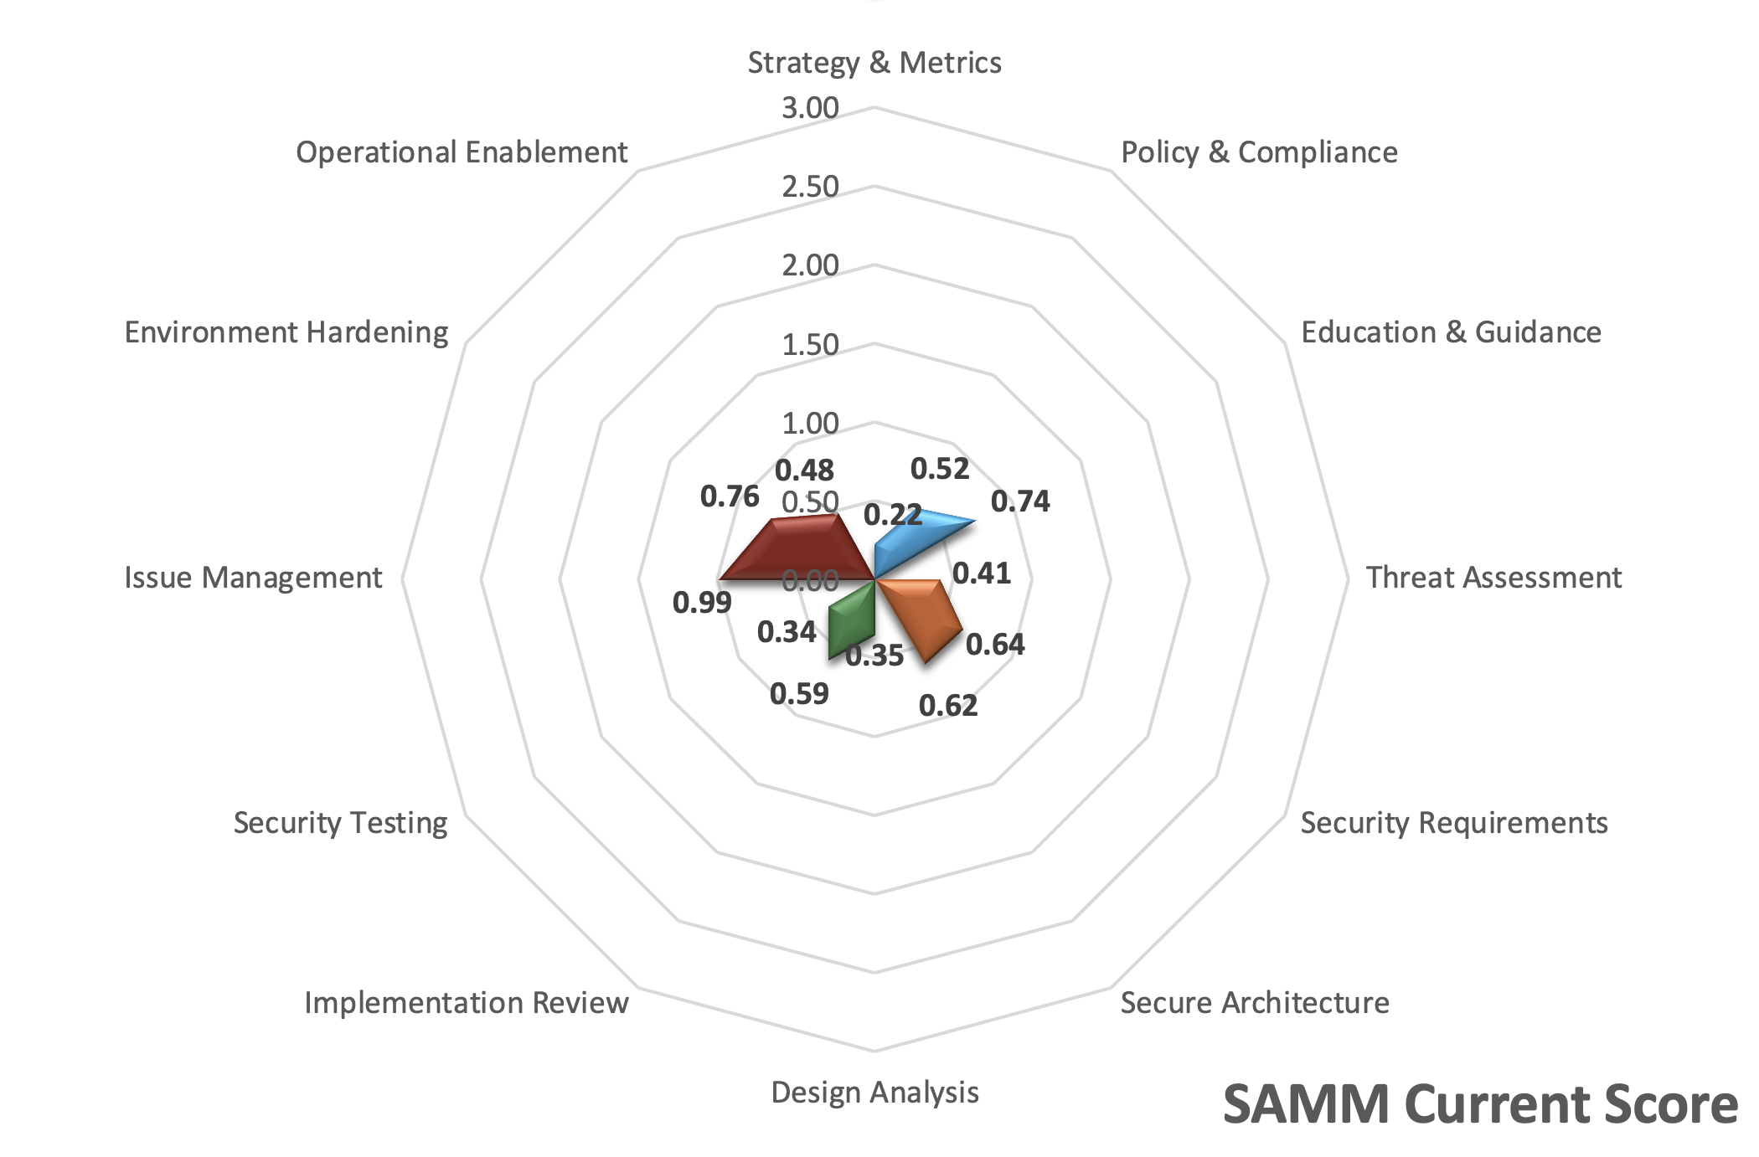
Current State
Operations
Governance
Verification
Construction

Slide 166




Creating and Enhancing an Application Assurance Program for “Your Company Name Here” One phase at a Time

Slide 167
First Year: Crawl
People
  Saltworks will supply a dedicated Client Principal for the first year to implement and inculcate the application assurance security program.
Process
  Saltworks will assist “redacted” in the creation of a central repository for application security processes, procedures, and guidance.
  Saltworks will establish processes for security testing of the “redacted” application and implement metric reporting for all testing to executive personnel.
  Saltworks will create threat a threat model for “redacted” and update it accordingly throughout the year.
Technology
  Saltworks will continue to work with the Development groups to utilize Fortify on Demand and as the Static Application Security Testing (SAST) and Dynamic Application Security Testing (DAST) technology.

Slide 168
Second Year: Walk
People
  Saltworks will keep utilizing the same Client Principal for the “redacted” project to enhance and mature the application assurance program.
Process
  Saltworks will implement security training for development staff in collaboration with “redacted”.
  Saltworks will implement a security champion program for “redacted”..
  Saltworks will continue to mature processes for security testing of “redacted”.
  Saltworks will continue to mature and verify the threat model for “redacted” and all accompanying microservices.
Technology
  Saltworks will continue to mature the Static Application Security Testing (SAST) program.
  Saltworks will continue to mature the Dynamic Application Security Testing (DAST) program.
  Saltworks will begin implementing manual penetration testing methodologies at “redacted”..

Slide 169
Third Year+: Run
People
  Saltworks will keep utilizing the same Client Principal for the “redacted”
Processes.
  Saltworks will continue to mature the application security champion program for “redacted”.
  Saltworks will continue to mature and verify threat models for the “redacted” application and all microservices.
Technology
  Saltworks will continue to mature the Static Application Security Testing (SAST) program.
  Saltworks will continue to mature the Dynamic Application Security Testing (DAST) program.
  Saltworks will continue to mature the Manual Application Testing program.

Slide 170
Thank You!

